Slide 1
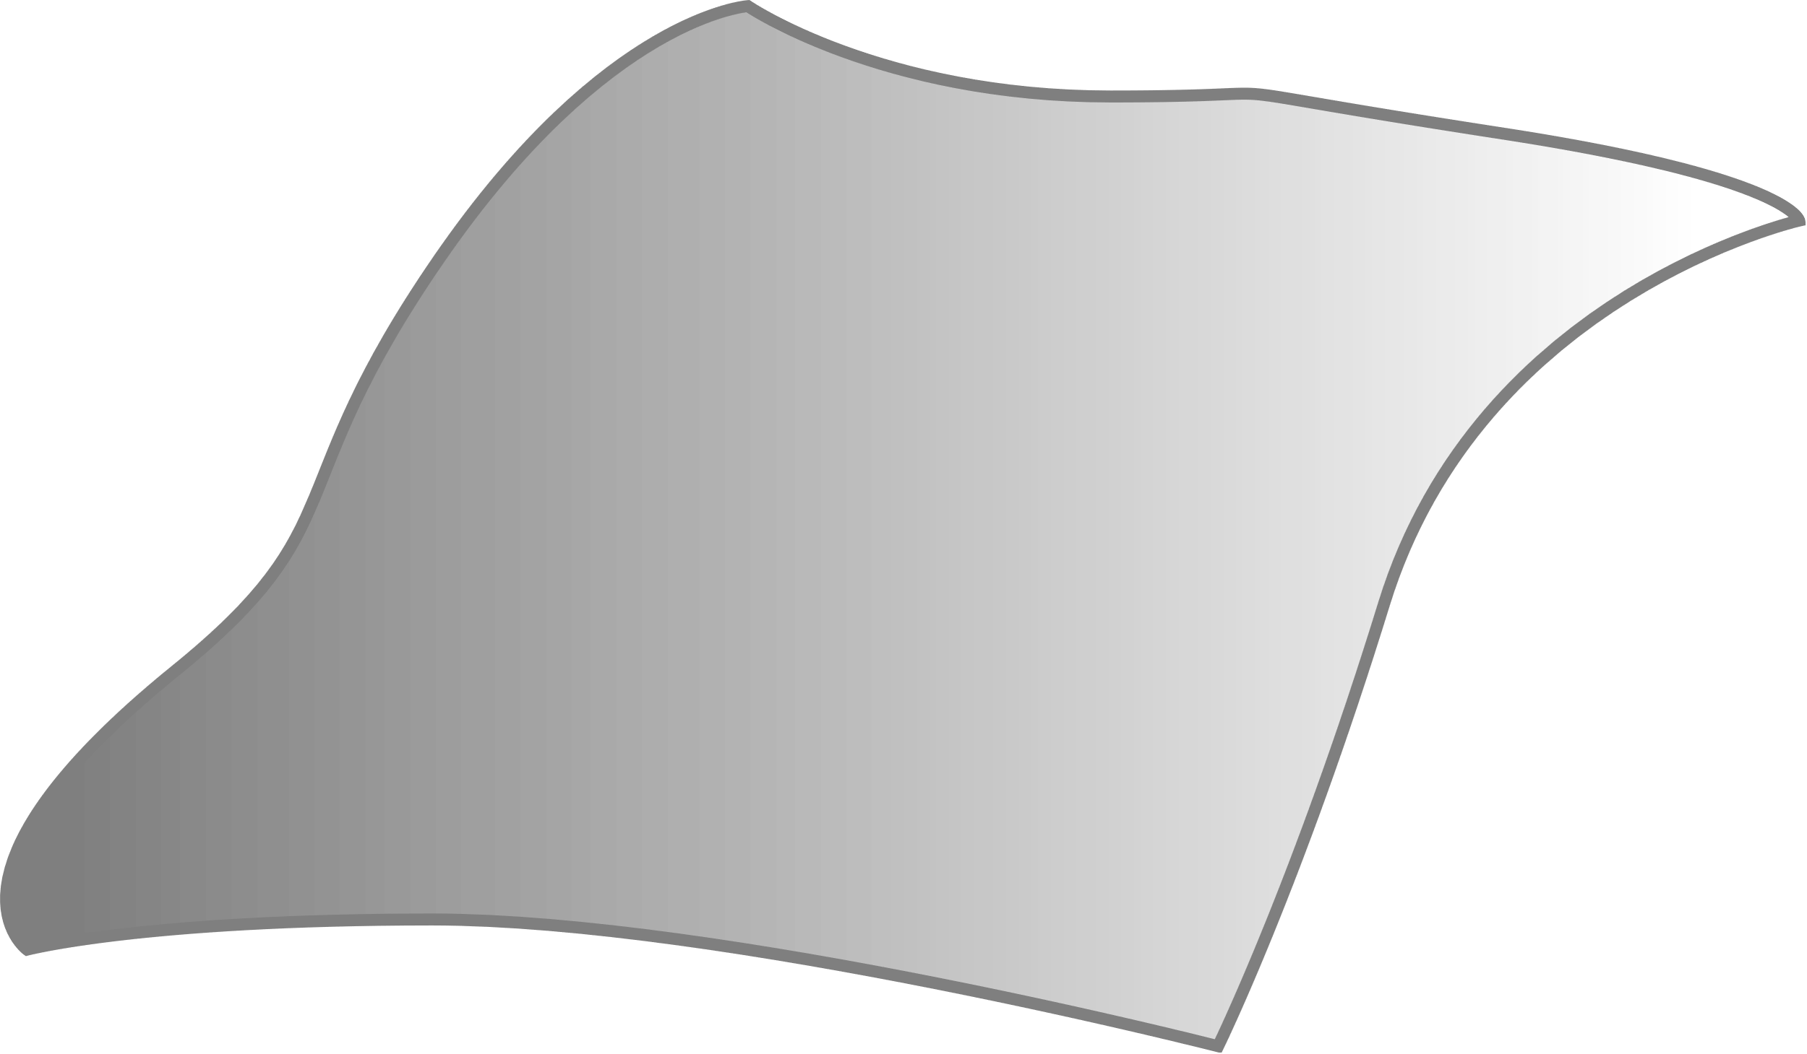
Middle plane

Slide 4
